Slide 1
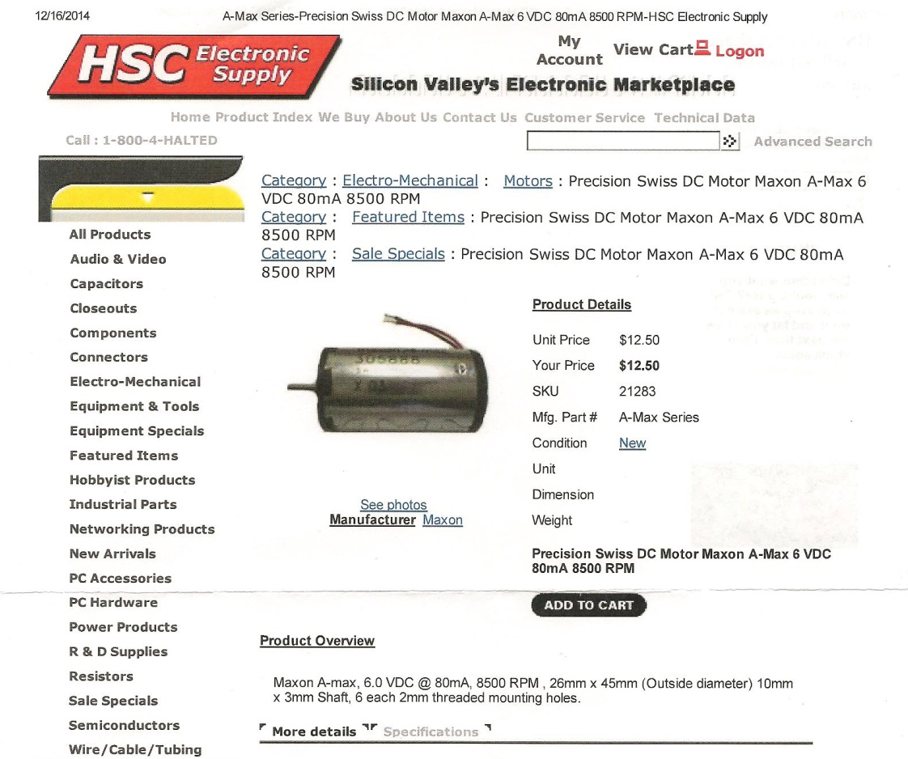
Outside diameter
Length (not including the shaft length

